Slide 1
Sales and Marketing Tips from the Field

Slide 2


Slide 3

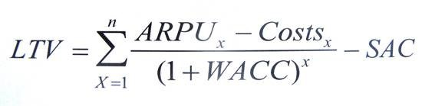
How do you know what to invest?
LTV (aka LCV)
CAC
5 key variables (the five horsemen) to the complete formula
ARPU (aka price)
Costs (annual cost to support the user during the period)
WACC
Avg customer lifetime (n)
Or estimate if unknown – if estimating, never more than 3 years and 2 is better
CAC – all of it. No really, everything

Slide 4

LTV – Helpful but…
It does not describe a strategy or any moat! “You can’t win a fight with a measuring tape”
The formula variables tug at each other
Business isn’t physics – your inputs are wrong
It is frequently misused and/or miscalculated
Obsession leads to myopia, lack of creativity and overspend
CAC almost always goes up over time, not down

Slide 5
Sales & Marketing Activities Depend on Stage
Outset
Customer Discovery
Customer validation and traction
Scaling

Slide 6









Strategy: Outset
Business model, core strategy (differentiation and defensibility) and distribution are all imperative for success and inextricably linked to sales
Business model innovation (and product!) is your best sales strategy
Nfx
Switching costs (lock-in)
Scale
IP
Counter-positioning
Brand
Great resources to think through strategy and business model advantages: 7 Powers by Hamilton Helmer; Blitzscaling by Reid Hoffman; Porter’s 5 Forces; SWOT

Slide 7
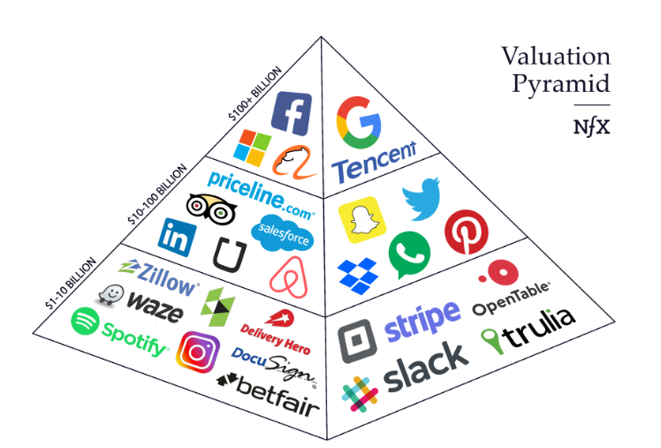
The Power of Network Effects (nfx)
Network effects have accounted for 70% of the value creation in digital companies
Of the 336 digital companies founded btwn 1994 and 2017 which are worth more than $1B, those driven primarily by nfx (35% by number) account for 70% of the total value created

Slide 8
Strategy: Customer Discovery
This is the CEO and the entire executive team’s job, not sales & marketing
Deeply understand your customers and how they relate to the problem and the product
What must they believe to buy your product? What do you displace?
Classic reference material is from Steve Blank
Use of customer personas can be useful
Serve your customers 1 on 1 in the early days to develop fit and enhance the product. Famous ex: Airbnb
Never relinquish the quest for compounding advantage which will make sales easier – IP, nfx, switching costs, brand

Slide 9

Strategy: Validation and Traction
Make decisions about sales model – must fit product, company and market
ASP, margin, repeat purchase and LTV are important for choosing the model
Direct usually = ASP>$50K and/or high repeat (leads to high LTV)
Inside sales is an alternative
Growth hacking is valuable. Use email marketing, free trials, freemium, SEM/SEO, internet marketing, and content marketing to build a funnel. Track in detail. Test and iterate.
Critical to use CRM early and often. Best practice sales forces deeply connected to the CRM as is growth marketing

Slide 10
Strategy: Validation and Traction (con’t)
Channels, Partners and distribution are key to consider.
Avoid blockers
Cheaper route to market (maybe)
Understand customer buying behavior and where offering fits into value chain
Most BD deals fail - but the ones that work can be powerful
Incentives are key to understand; must have major resources committed from the partner.
Direct sales has higher LTV, more control, but higher sales costs and lower reach
Usually she who controls the customer has the power
Counter example: WinTel – but this was driven by powerful Nfx and Scale
Tesla wisely chose direct

Slide 11
Are BD and Sales the Same? What is BD?
BD enables new markets, partnerships, channels and other forms of distribution
Sometimes BD comes first, before sales or before sales in a new market or product
BD people different than sales people!
Product sense is critical; Legal understanding; Creative; Structured enough to run a long deal process; Tenacious and focused; Strategic enough to understand needs and trade-offs of both sides
Early sales almost always look more like BD than sales
Phases of a deal: Ideation; Pitching; Negotiating; Structuring; Closing; Implementing

Slide 12
Strategy: Scaling!
Begin to scale with signs of product market fit
Hiring sales people too early may waste $ and poison the market if done before there is at least initial product market fit
Is the maxim “if you’re not embarrassed by your first product then you launched too late” true?
And hiring expensive sales people may (hopefully) not even be required!
Define key sub (or even micro) segments where offering has best differentiation and highest LTVs. FOCUS!
Now time to hire a key sales exec that is good at building a sales team – hire for 12 to 18 months. Don’t go for sales central casting
Key question: Do you wait for unit economics to be proven?
Depends. Is speed critical? If yes, then you launch without revenue model and proven unit economics. If no and/or growth costs are extraordinarily high, then you wait
“Most great companies historically have had good unit economics soon after they began monetizing” –Sam Altman
If there are network effects, customer switching costs or clear gains from scale, then pour on the gas b/c if you don’t, someone else may. Refer to CAC/LTV

Slide 13
Strategy: Scaling! (con’t)
As a company scales, a half-rate but clearly defined sales process is better than no sales process. Why? It can be tested and improved with clarity!
great reference: “Predictable Revenue”
Many sales teams split key functions. BDRs take leads and research, qualify and set appointments; sales execs find solution fit and close.
Build a client success function and owner – who is not sales!
But it is good for sales have skin in the game
Create user groups, conferences, speakers/champions, social media buzz – build momentum and lock-in

Slide 14

Sales Hiring
Your first hire does not need to be your sales VP
Look for domain expertise – always important but especially in the early stages
Example: VTS vs. Hightower.
Key Sales VP hiring criteria
Their hiring criteria
Ability to grasp the business model and suggestion areas to experiment
Can she effectively pitch you on current/last company product
Can she define a sales process and factors to consider in creating it?
Can he describe how to build and execute a training program?
Can she explain sales comp plans and why to choose them?
Excellent resource: The appendix in “The Hard Thing about How Things” by Horowitz

Slide 15
Marketing Defined
Strategy and positioning
Growth Hacking -- Analytical marketing that includes online advertising, email marketing, SEO, content marketing, viral marketing and funnel optimization. Covers lead/demand gen through to early stages of conversion
Product Marketing -- Customer testimonials, user testing and interviews, competitor analysis, collateral generation, white papers, explainer videos, case studies
PR and comms -- Press relations, events, consultant and thought leader relations, social media, story telling
Brand Marketing -- The squishier side of company/product awareness, perception and associations. Generally includes logos and advertising.

Slide 16
Marketing Tips
Do you need marketing and when and what type? Depends very much on customers, product, business model and growth vectors
No/low marketing examples: Tesla and Wish. Rare in consumer and typically driven by incredible product differentiation → free PR and word of mouth
How to hire a head of marketing
Determine type of marketing most important and look for experience in that area
Look for an overall good athlete b/c probably they’ll need to cover many/all of these areas. This is hard. The days of someone that could buy ads and pick color schemes and jingos are gonzo
Marketing automation software. Marketo, Hubspot, others. Generate and nurture leads. Team should know what they need and why.

Slide 17
Viral vs. Nfx vs. Big Data vs. Scale
None of these are the same thing, but often confused
Viral growth – exponential growth usually resulting from social media or some other growth hack
Ex: Paypal gave $20 for referrals to new customers and to the referrer
Nfx: each new user increases value of all users
Growth may be viral…or not. Ex: Airbnb went nowhere >3 years
Big Data – many big companies have huge quantities of valuable data but without Nfx or viral growth. Still valuable!
Scale – scale advantages result from size, not Nfx. Netflix has a large scale advantage and small Nfx. VW has a huge scale advantage and no nfx.

